Slide 1

Paper Title: Automatic Detection of Relevant Information, Predictions and Forecasts in Financial News through Topic Modelling with Latent Dirichlet Allocation
Presented by
Shubham Jaysukhbhai Kothiya
018217901

Slide 2

SHUBHAM KOTHIYA
Problem Statement
Information Overload: Investors face a daily deluge of financial news, making it challenging to identify crucial trends and insights.
TimeConstraint: Processing vast amounts of information manually is time-consuming and inefficient.
Decision-Making Challenges: The sheer volume of data can lead to analysis paralysis, hindering timely and informed investment decisions.

Slide 3

What is a Financial Analysis System?
SHUBHAM KOTHIYA
A financial analysis system uses tools to derive insights from data like stock prices and market trends.
Core Objectives:
Data Extraction: Collecting data from various sources.
Pattern Identification: Using models to find trends and anomalies.
Prediction: Forecasting market behavior and financial outcomes.
Decision Support: Assisting users in optimizing investments and minimizing risks.

Slide 4







SHUBHAM KOTHIYA
Challenges in Traditional Financial Analysis Systems
Challenges in Distinguishing Relevant Information:
faces difficulties in filtering out unnecessary or repetitive information within financial news, resulting in information overload for analysts.
Lack of Temporal Understanding :
fails to differentiate between past, present, and future financial events, which is critical for forecasting. They rely primarily on timestamps or verb tenses without considering semantic context.
Inability to Handle Unstructured Financial Data :
Unstructured textual data like news articles and reports are challenging to process using traditional methods, which rely on predefined templates or rule-based approaches.

Slide 5

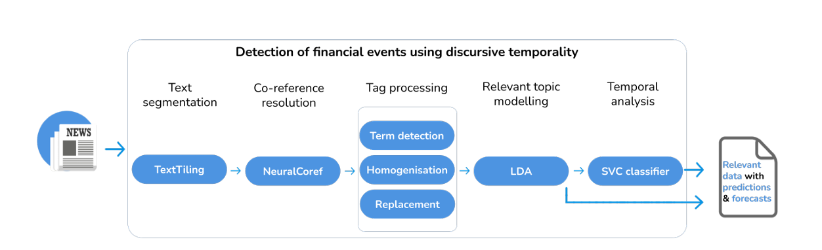

LARANA COMPANY
PROPOSED SYSTEM

Slide 6
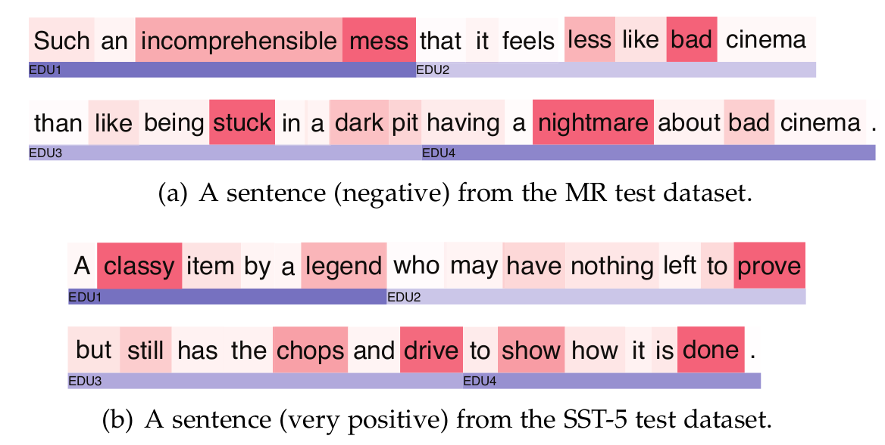
SHUBHAM KOTHIYA
Text Segmentation (TextTiling)
Main Purpose: Breaks down financial news into meaningful segments that contain related information
Key Function: Groups similar content together using word patterns and relationships
Minimum text length: 500 characters
Practical Output: Creates self-contained sections that focus on specific topics or statements about financial events

Slide 7

SHUBHAM KOTHIYA
Co-reference Resolution (NeuralCoref)
Purpose: Replaces vague references (like "it", "they") with actual names and terms for better clarity
Neural Network Components:
Mention-pair encoder: Processes pairs of text references
Cluster-pair encoder: Groups related references together
Example: Changes "its price" to "VZ stock price" for clearer meaning

Slide 8

SHUBHAM KOTHIYA
Tag Processing
Standardizes financial text by converting specific terms into consistent formats
Smart Conversion:
Replaces stock markets with → STOCK
Converts assets to → TICKER
Transforms currencies to → CURRENCY
Simplifies financial terms to → FIN_ABR
Data Standardization:
Standardizes dates as → DATE
Converts numbers to → NUM
Uses Name Entity Recognition (NER)

Slide 9
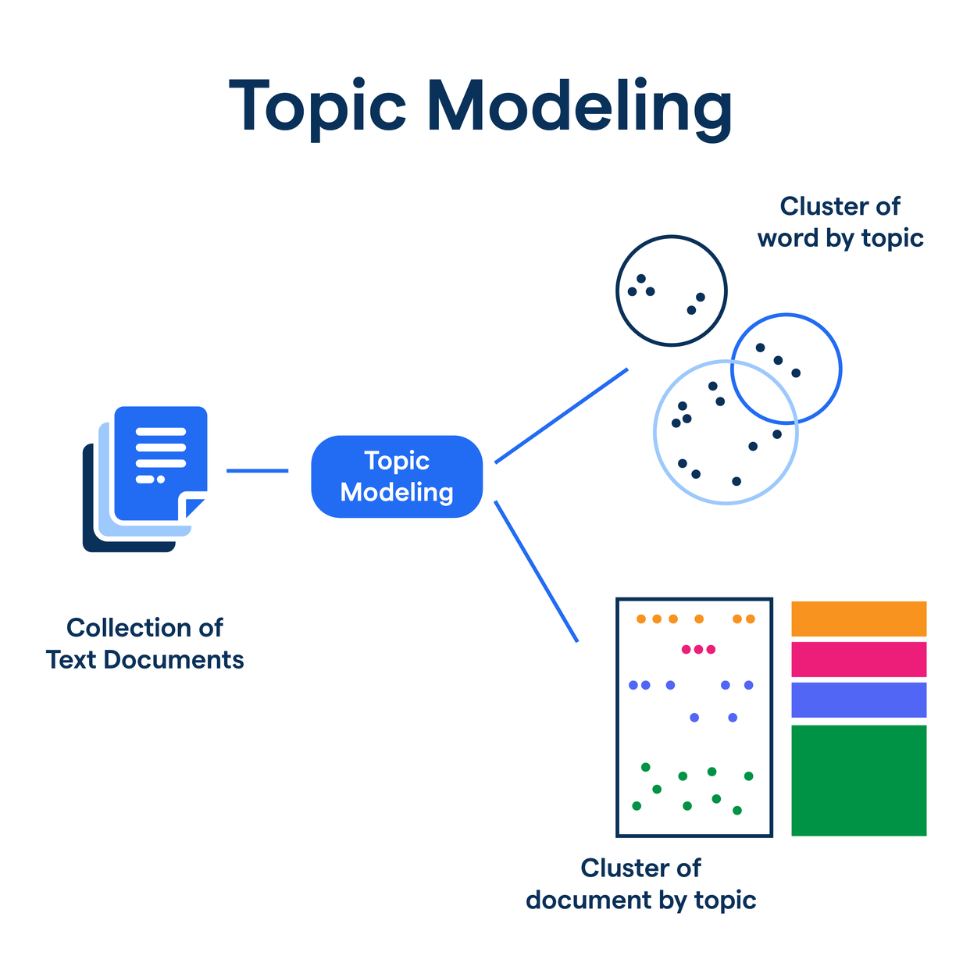
SHUBHAM KOTHIYA
Relevant Topic Modeling (LDA)
Purpose: Separates relevant from non-relevant information in financial news
Core Technique: Uses a two-topic Dirichlet distribution model
Key Parameters:
α: Controls topic density in documents
β: Controls word density within topics
Relevance Scoring:
ρ (Topic Score): Measures density of financial tags
δ (LDA Score Threshold): Filters for truly relevant content

Slide 10
SHUBHAM KOTHIYA
Temporal Analysis (SVC Classifier)
Purpose: Detects future predictions and speculative statements in financial news text
Analysis Level: Examines individual sentences to understand their temporal context and meaning
Key Components:
Analyzes syntax structure and semantic meaning
Identifies temporal markers (e.g., "will," "expect," "forecast")
Recognizes pattern combinations that indicate predictions

Slide 11



SHUBHAM KOTHIYA
Results & Performance Metrics
Accuracy Scores based on scale of 2158 financial news items:
Identifies 66.2% of relevant financial news content.
Achieves 98.2% accuracy in spotting predictions and forecasts.

Slide 12

SHUBHAM KOTHIYA
Main Applications
Investment Decision Support
Automatic filtering of pertinent financial information
Identification of predictions and forecasts from news articles
Real-time market insights to enhance decision-making speed
Personal Finance Management
Streamlined news digestion for individual investors
Tailored alerts for specific assets or markets
Mitigation of information overload
Risk Assessment
Early detection of signals indicating market volatility
Recognition of potential market risks
Examination of market sentiment patterns

Slide 13
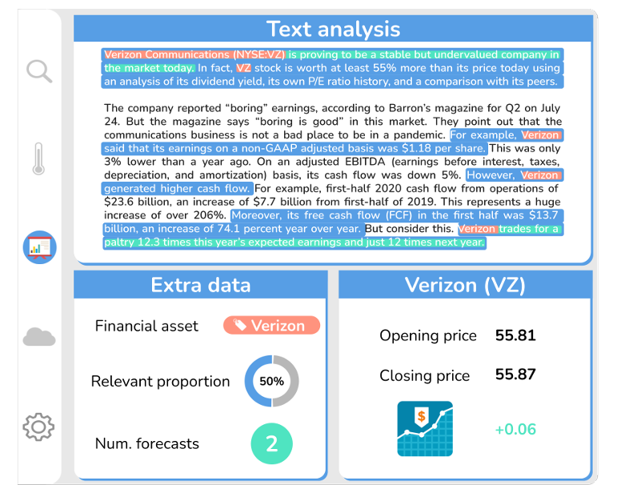
SHUBHAM KOTHIYA

Slide 14

SHUBHAM KOTHIYA
Future Scope
Enhanced Co-reference Resolution: Improve accuracy in resolving complex entity references
Multilingual Support: Expand to handle news in multiple languages
External Data Integration: Incorporate social media sentiment and economic indicators
Customizable Topic Modeling: Allow users to define custom topics of interest

Slide 15
REFERENCES
Paper Referenced:
Silvia García-Méndez, Francisco de Arriba-Pérez, Ana Barros-Vila, Francisco J. González-Castaño and Enrique Costa-Montenegro Automatic Detection of Relevant Information, Predictions and Forecasts in Financial News through Topic Modelling with Latent Dirichlet Allocation
https://arxiv.org/pdf/2404.01338
Related paper work:
Delić V, Perić Z, Sečujski M, et al (2019) Speech Technology Progress Based on New Machine Learning Paradigm. Computational Intelligence and Neuroscience 2019:1–19.
https://doi.org/10.1155/2019/4368036
Guetterman TC, Chang T, DeJonckheere M, et al (2018) Augmenting Qualitative Text Analysis with Natural Language Processing: Method ological Study. Journal of Medical Internet Research 20(6):e231.
https: //doi.org/10.2196/jmir.9702
For Images:
https://www.freepik.com/vectors/financial-systems-analysis

Slide 16
THANK
YOU
Shubham Kothiya

